Slide 1

The ABAP RESTful Programming Model
Graham Robinson
Yelcho Systems Consulting

Slide 2




Introduction
@grahamrobbo
*Photo by Martin Gillet

Slide 3
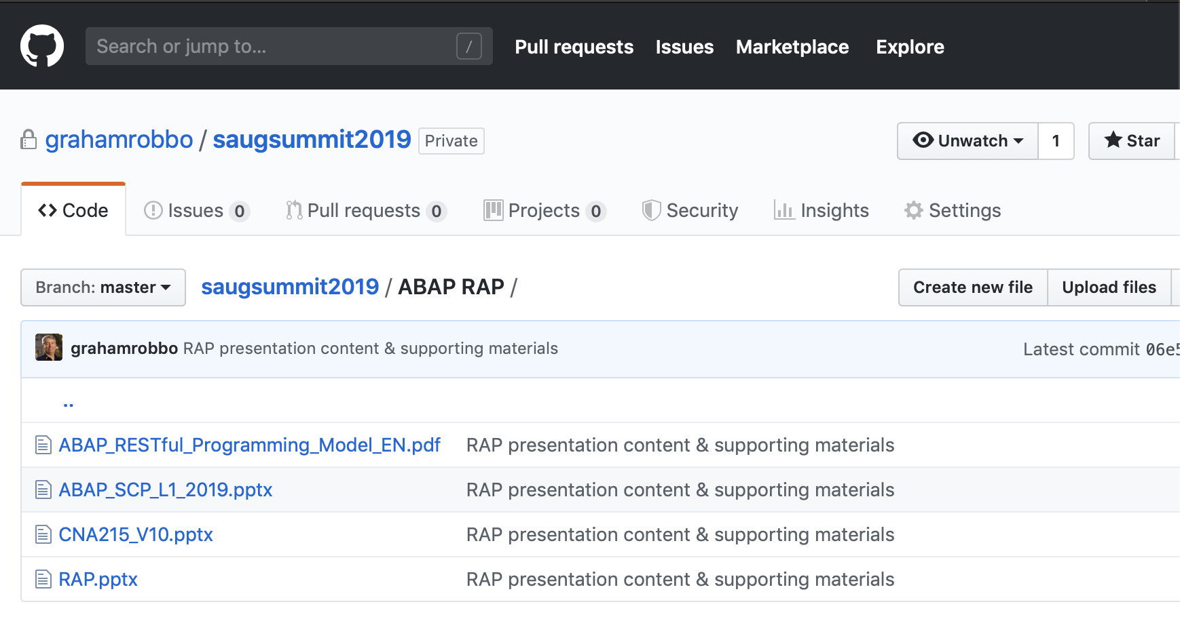

Slide 4
Evolution of the ABAP programming model
ABAP Platform ≤ 7.5
ABAP Platform ≥ 7.5
SAP Cloud Platform ABAP Environment ≥ 1808 *
CLASSIC ABAP PROGRAMMING
ABAP PROGRAMMING MODEL FOR SAP FIORI
ABAP RESTful PROGRAMMING MODEL
SEGW / @OData Referenced Data Source
Business Service
Best practice freestyle ABAP programming
Core Data Services (CDS)
CDS-based BOPF
Core Data Services
Behavior Definition & Implementation
Dos and Don’ts
Be prepared for the new programming models
Current best practice in SAP S/4HANA
Recording from SAP TechEd 2017
Documentation
Future direction
Today’s session
Documentation
Safe investments! Integration planned for 2020
* Reduced scope available on-premise as of SAP S/4HANA 1909

Slide 5

ABAP RESTful Programming Model – The key players
ABAP Development Tools in Eclipse for all development tasks
Easy developer onboarding End-to-end development flow
Language: ABAP and CDS
Standard implementation tasks via typed APIs supporting static code checks, auto-completion, element info
Frameworks
Take over technical implementation tasks Business logic added in code exits on protocol agnostic layers

Slide 6


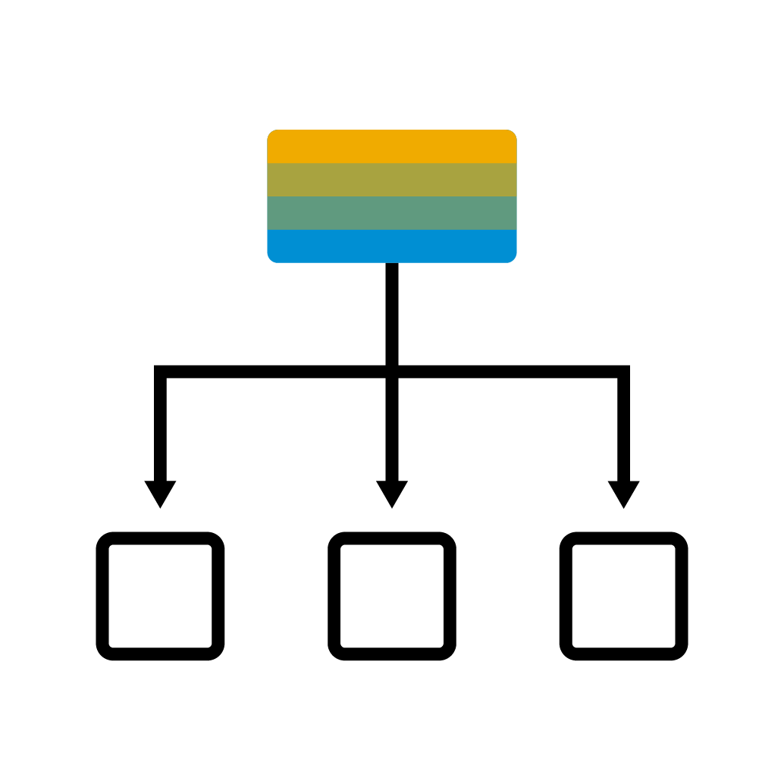


ABAP RESTful Programming Model – The big picture
SERVICE CONSUMPTION
SAP Fiori UI Consume OData UI services
Web API Consume OData Web APIs
SERVICE BINDING Bind to protocol version and scenario
BUSINESS SERVICES PROVISIONING
SERVICE DEFINITION Define scope to be exposed
CDS: Projection Views
BDEF: Behavior Projection
BUSINESS OBJECTS
QUERIES
CDS: Data modeling
DATA MODELING & BEHAVIOR
CDS: Data modeling
BDEF: Behavior definition
ABAP: Behavior implementation

Slide 7
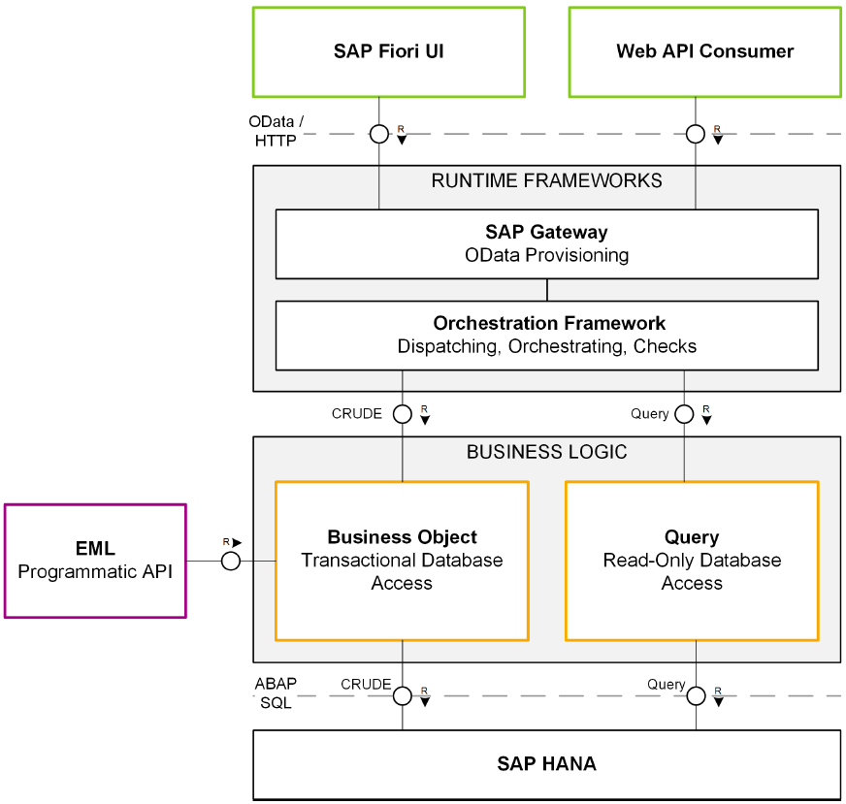
Runtime

Slide 8
Let’s see the code …

Slide 9

Business object runtime
BUSINESS OBJECT RUNTIME
INTERACTION PHASE
SAVE SEQUENCE
MODIFY
READ
LOCK
finalize
check_before_save
execute_action
execute_function
read
create
read_by_association
update
delete
create_by_association
lock
adjust_numbers
save
TX buffer
SAP HANA

Slide 10
Business objects - status overview
INTERACTION PHASE
SAVE SEQUENCE
UNMANAGED
Application coding available (e.g. Purchase Order, Sales Order,…)
1
finalize
MODIFY
check_before_save
LOCK
READ
MANAGED
Green field development
2
adjust_numbers
save
(MANAGED WITH) SAVE SELF-IMPLEMENTED
Update task function module available (e.g. Business Partner, Product,..)
3
TX buffer
SAP HANA

Slide 11

Business objects - unmanaged
INTERACTION PHASE
SAVE SEQUENCE
Application coding
already available
for interaction phase, transactional buffer and save sequence
decoupled from UI technology
Examples
Sales Order, Purchase Order
finalize
MODIFY
checkBeforeSave
LOCK
READ
adjustNumbers
save
APPLICATION CODE
TX Buffer
Adapter
SAP HANA

Slide 12

Business objects - managed
INTERACTION PHASE
SAVE SEQUENCE
Application coding
not yet available or fine granular reusable code available
technical implementation tasks taken over by BO infrastructure
developer focus on business logic, implemented via code exits: determinations, validation, actions,…
Examples
New applications in SAP Cloud Platform ABAP Environment
finalize
checkBeforeSave
MODIFY
LOCK
READ
adjustNumbers
save
MANAGED RUNTIME
TX Buffer
Business Logic via determinations, validations
SAP HANA

Slide 13
Business objects - save unmanaged
INTERACTION PHASE
SAVE SEQUENCE
Application coding
“update-task function module” available
coding for interaction phase not available (e.g. highly coupled in older UI technology: DYNP - PBO / PAI)
technical implementation aspects to be taken over by BO infrastructure
Examples
Business Partner, Product
finalize
checkBeforeSave
MODIFY
LOCK
READ
adjustNumbers
save
MANAGED RUNTIME
Function module for UPDATE TASK
TX Buffer
SAP HANA
Application code in determinations / validations / …
SAP HANA

Slide 14
ABAP RESTful Programming Model – The big picture
SERVICE CONSUMPTION
SAP Fiori UI Consume OData UI services
Web API Consume OData Web APIs
SERVICE BINDING Bind to protocol version and scenario
BUSINESS SERVICES PROVISIONING
SERVICE DEFINITION Define scope to be exposed
CDS: Projection Views
BDEF: Behavior Projection
BUSINESS OBJECTS
QUERIES
CDS: Data modeling
DATA MODELING & BEHAVIOR
CDS: Data modeling
BDEF: Behavior definition
ABAP: Behavior implementation

Slide 16
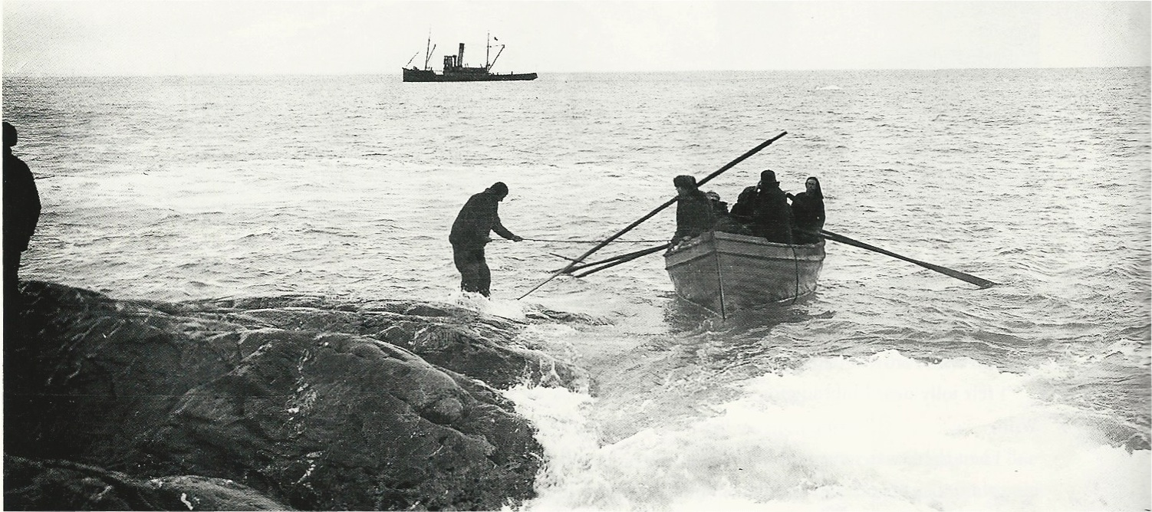


@grahamrobbo

